Slide 1



Batch industrial control system
Cairo University
Faculty of Engineering
Credit Hour System Programs
Under Supervision of:
Prof. Dr. Magdy Abd-ElGhany

Slide 2

Submitted By
Mahmoud Muhammed Muhammed
Mohamed Khaled Abdo
Ali Mahmoud Ali
Mahmoud Emad Eldin Elsayed

Slide 3
01
Introduction
02
Project hardware
CONTENTS
03
Project Software
04
Conclusion

Slide 4
Introduction

Slide 5
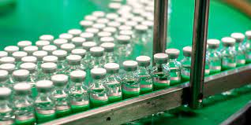
Introduction
Batch control system on large scale is widely used in chemicals, petrochemicals and pharmaceuticals industries.

Slide 6
Introduction
The project is to mimic the batch process which is tank filling, heating, mixing and emptying.
In our project we are using different technologies which are connected together to reach the best possible result, these technologies are PLC, SCADA system, IoT.

Slide 7
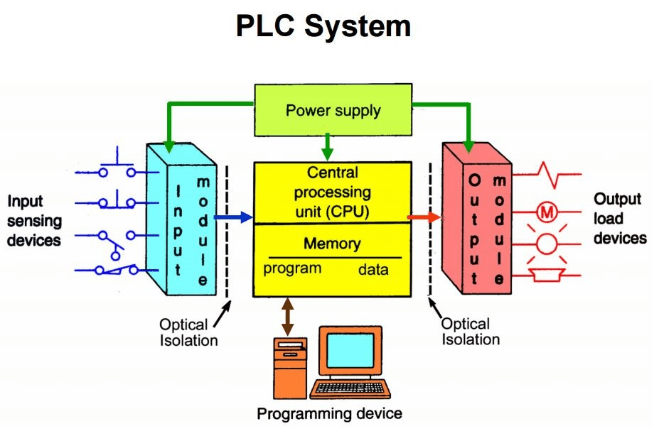
PLC
An industrial micro-Processor based device capable of dealing with different process inputs and outputs to achieve:
Sequential Logic Control Functions
Automatic Control Functions (digital control)

Slide 8
SCADA system
In modern manufacturing and industrial processes, It’s often needed to connect equipment and systems separated by large distances. This can range from a few meters to thousands of kilometers from here we can use Scada system.
SCADA systems are crucial for industrial organizations since they help to maintain efficiency, process data for smarter decisions, and communicate system issues to help mitigate downtime.

Slide 9
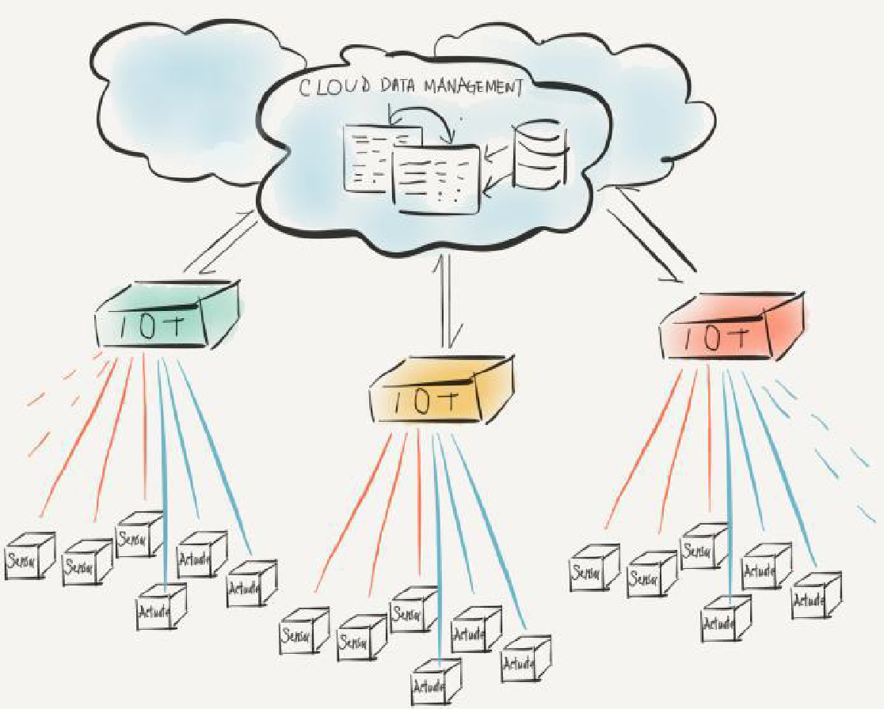
IOT
What’s IoT?
The Internet of Things, definitions by organizations such as IEEE:
A mechanism for connecting physical items to the internet
A network of items-each embedded with sensors-which are connected to the Internet.

Slide 10
IOT
How does it work?
1- we use Arduino Uno as a brain of the system, it transmits, receives and process data through sensors connected to the system.
2- It comes with an ATMEGA microcontroller that processes the data and facilitates the proper working of the IoT system.

Slide 11
IOT
3- using C programming for the Arduino you can make various projects of Iot.
4- IDE software is needed for Arduino based IoT projects.
5-you need to use ESP-8266 WIFI module to establish the WIFI communication between the Arduino and cloud platform.

Slide 12
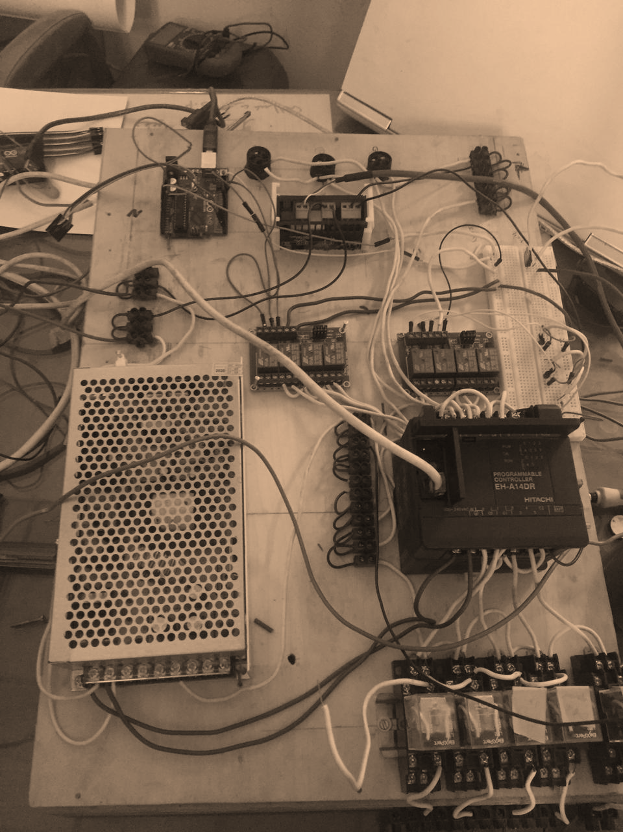
Project Hardware

Slide 13
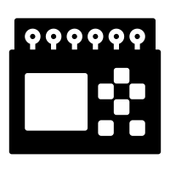

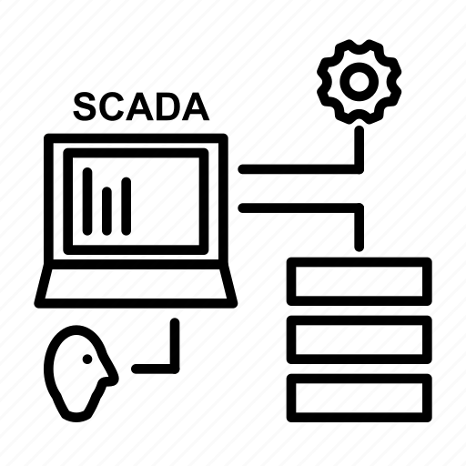



Project Components
I/O list
PLC
Microcontrollers and IoT
Inputs | Outputs
3 PBs (Start- M level – H level) | 3 Valves
Ultrasonic Sensor | Motor (mixer)
Temperature sensor | Heater
SCADA
Motors and valves
Sensors and actuator
Relays

Slide 14
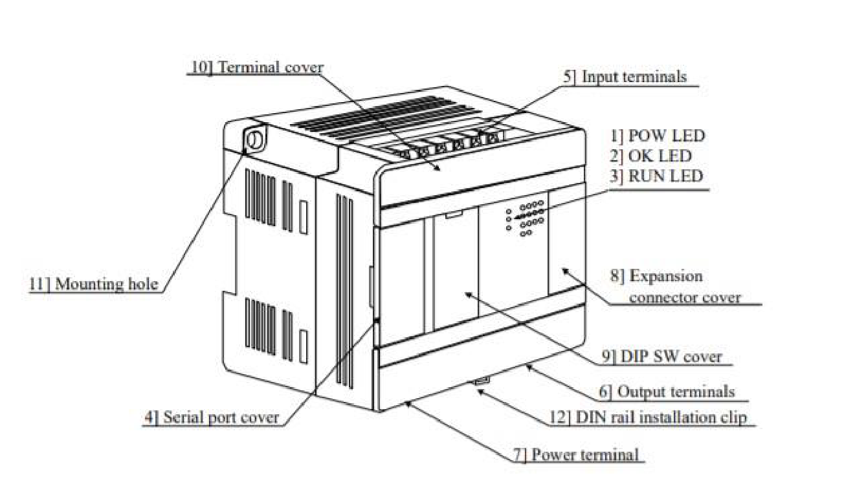
PLC
1- PLC (Hitachi EH-A14EDR)
It has 8 input Points and 6 output points. The input voltage is 24V DC. The output points are relay outputs type.

Slide 15
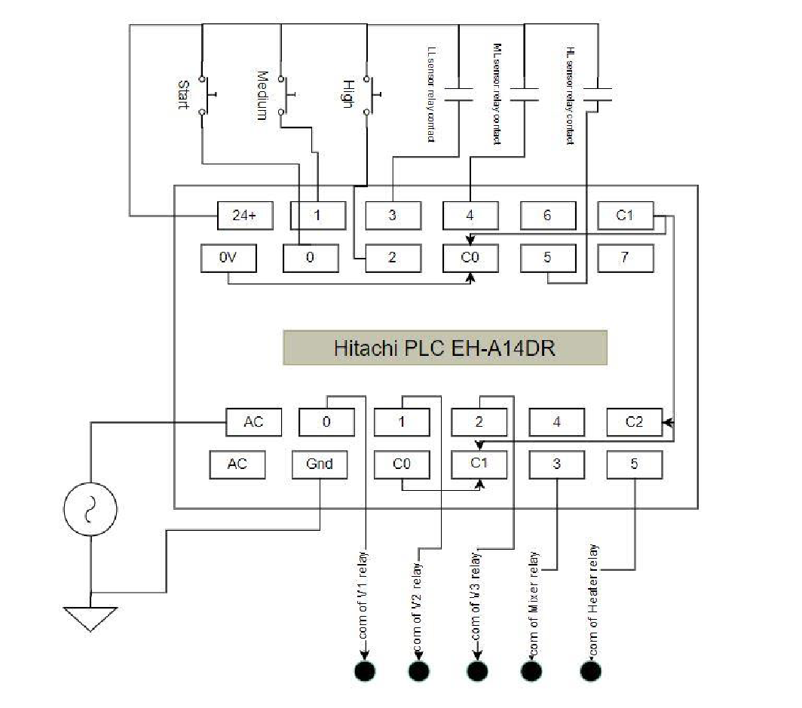
Wiring of PLC

Slide 16
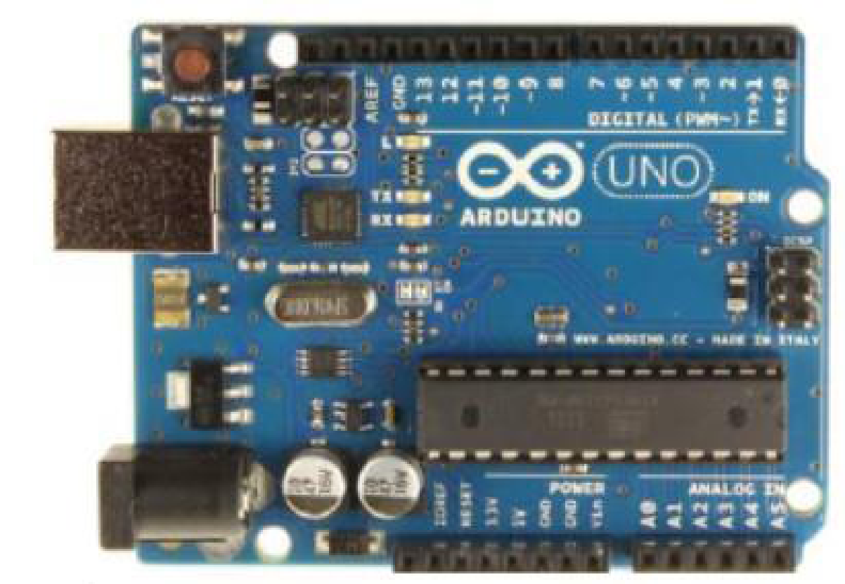
Arduino Uno and WIFI module
Microcontroller | ATmega328
Operating Voltage | 5V
Input Voltage (recommended) | 7-12V
Input Voltage (limits) | 6-20V
Digital I/O Pins | 14 (of which 6 provide PWM output)
Analog Input Pins | 6
DC Current per I/O Pin | 40 mA
DC Current for 3.3V Pin | 50 mA
Clock Speed | 16 MHz

Slide 17
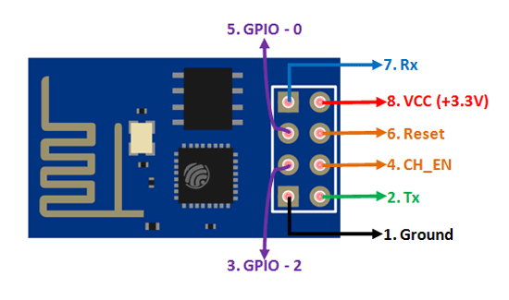
Arduino Uno and WIFI module
Pin Number | Pin Name | Normally used for
1 | Ground | Connected to the ground of the circuit
2 | TX | Connected to Rx pin of programmer/uC to upload program
3 | GPIO-2 | General purpose Input/output pin
4 | CH_EN | Chip Enable – Active high
5 | GPIO - 0 | General purpose Input/output pin
6 | Reset | Resets the module
7 | RX | General purpose Input/output pin
8 | Vcc | Connect to +3.3V only

Slide 18
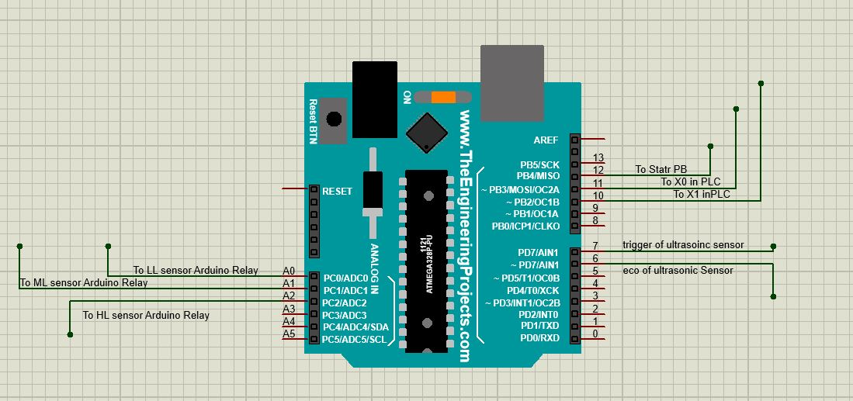
Wiring of Arduino

Slide 19
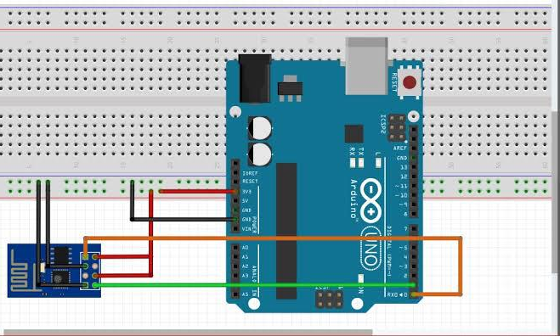
Wiring of WiFi module

Slide 20
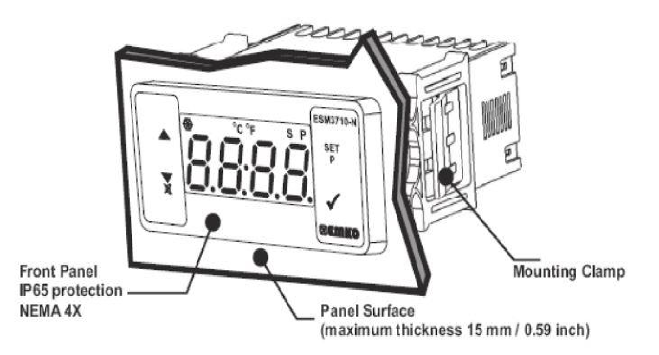
Temperature controller
ESM-3710N series temperature controllers are designed for measuring and controlling temperature. They can be used in many applications with their ON / Off control form, heating and cooling control form and easy-use properties.

Slide 21
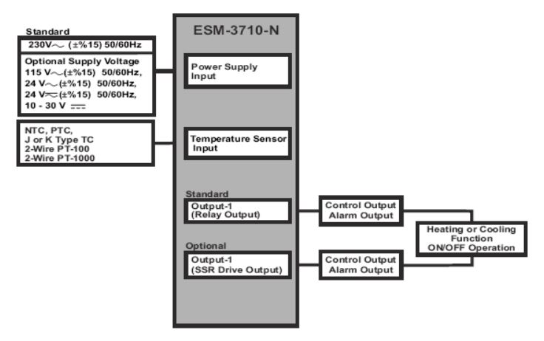
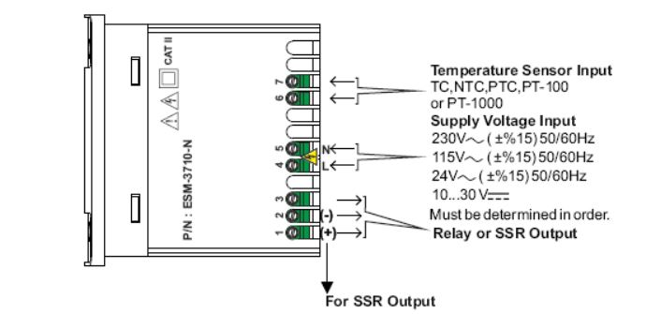
Wiring of temperature controller

Slide 22
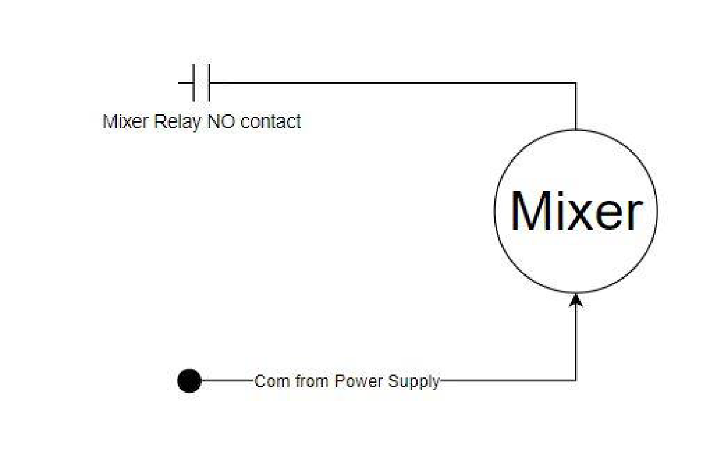
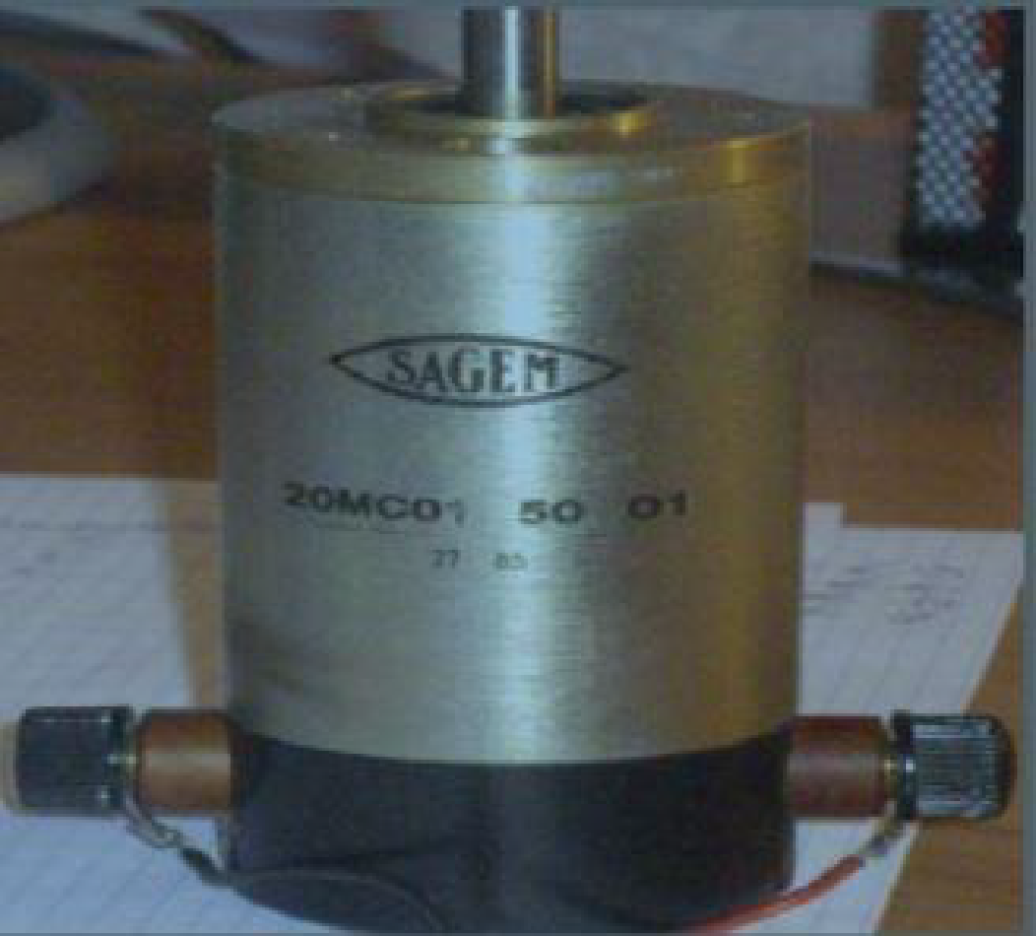
DC motor

Slide 23
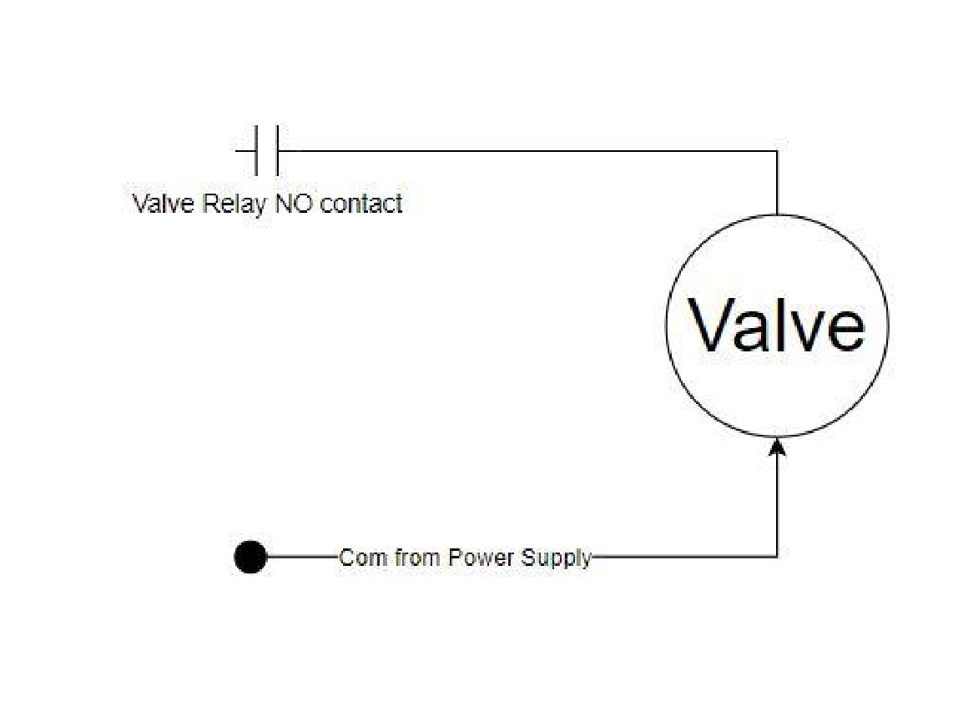
Valves
Solenoid Valves: In our project we use 3 solenoid valves.

Slide 24
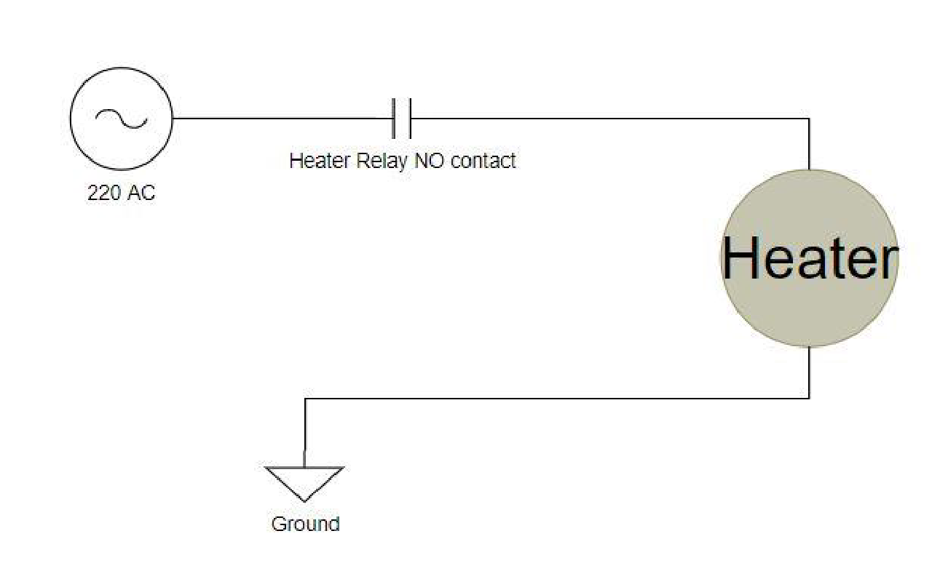
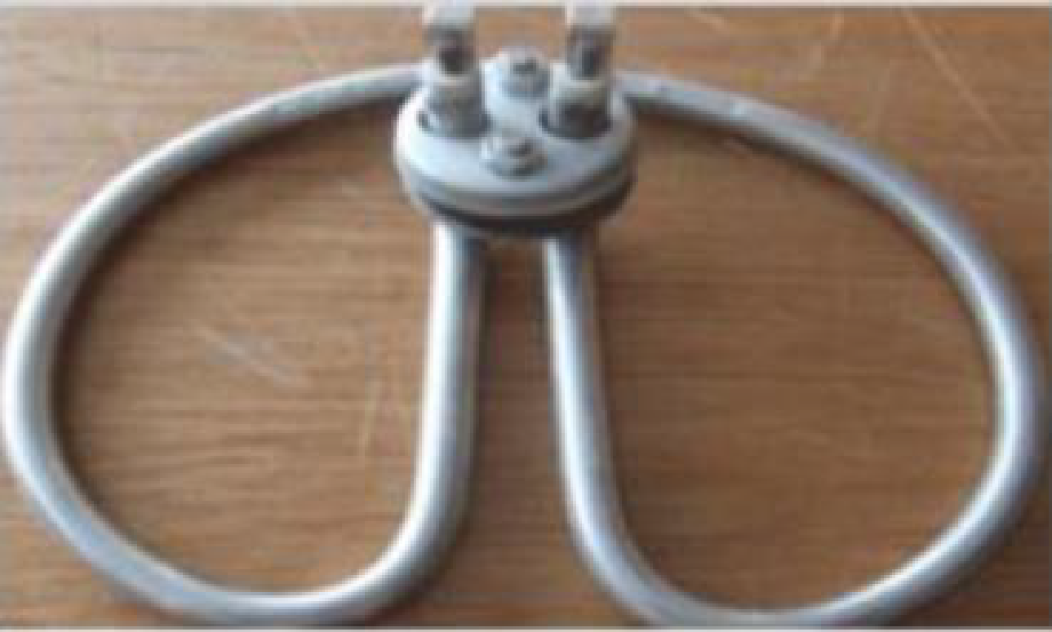
Heater
heater: 220 VAC ,1500 Watt

Slide 25
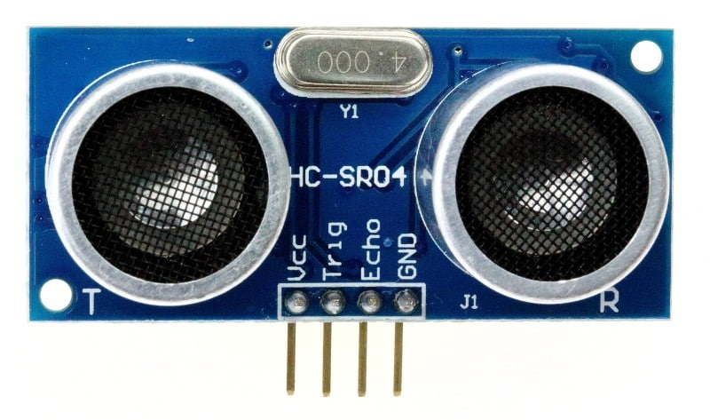
Ultrasonic sensor
An ultrasonic sensor is an electronic device that measures the distance of a target object by emitting ultrasonic sound waves, and converts the reflected sound into an electrical signal.

Slide 26
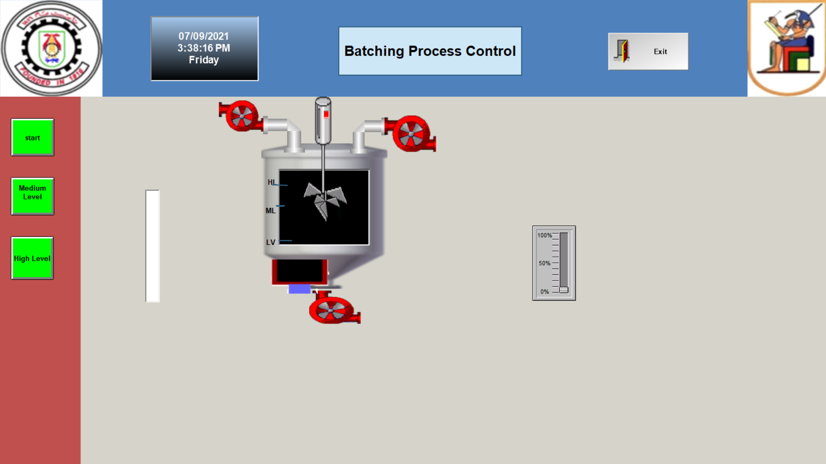
Project Sequence
Filling by V1
heating
Filling by V2
Mixing
Emptying

Slide 27
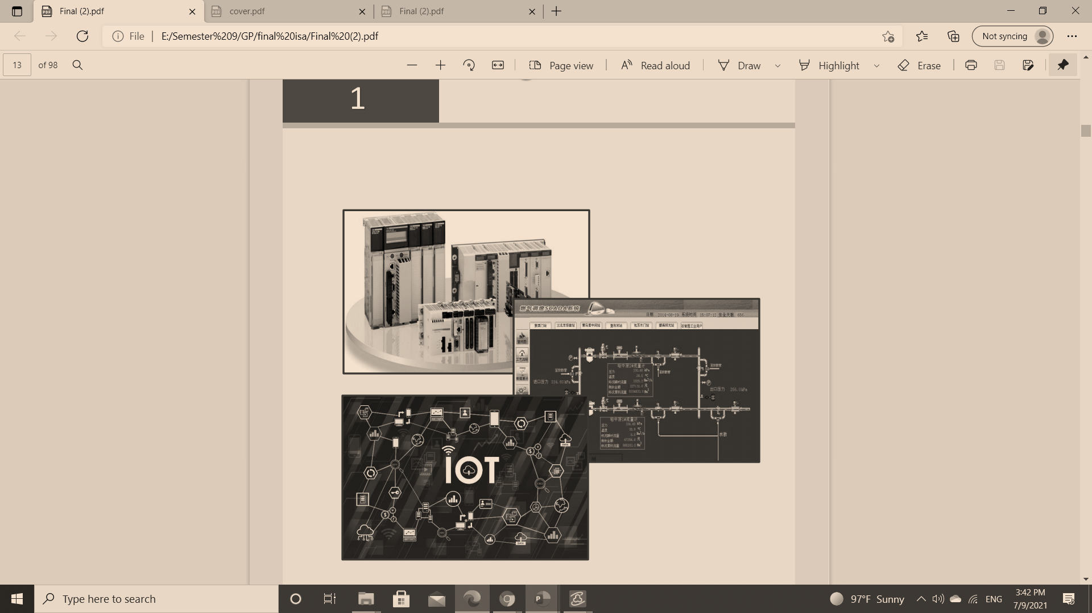
Project Software
PLC Programming
Scada Implementation
IOT

Slide 28
PLC programming
The used plc is HITACHI EH-A14DR and its software for programming is ACTWIN software

Slide 29
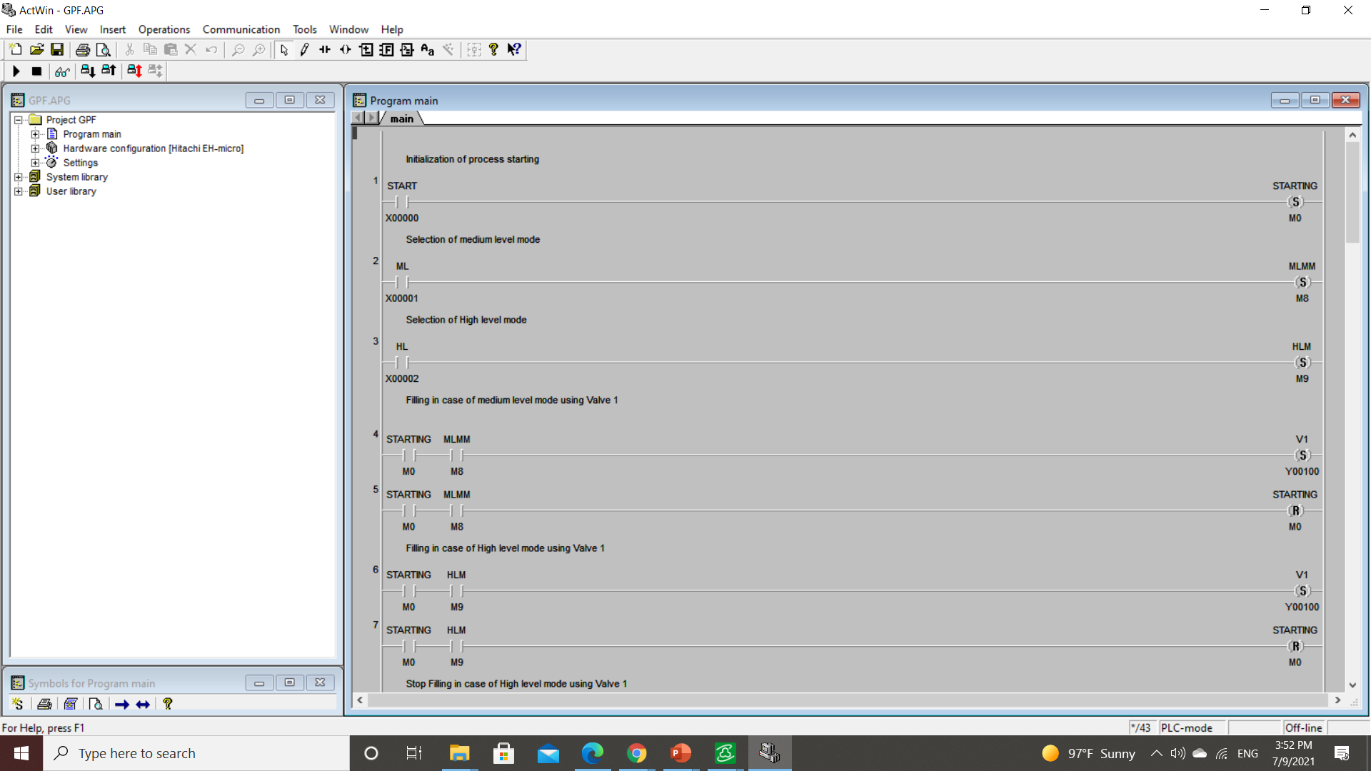
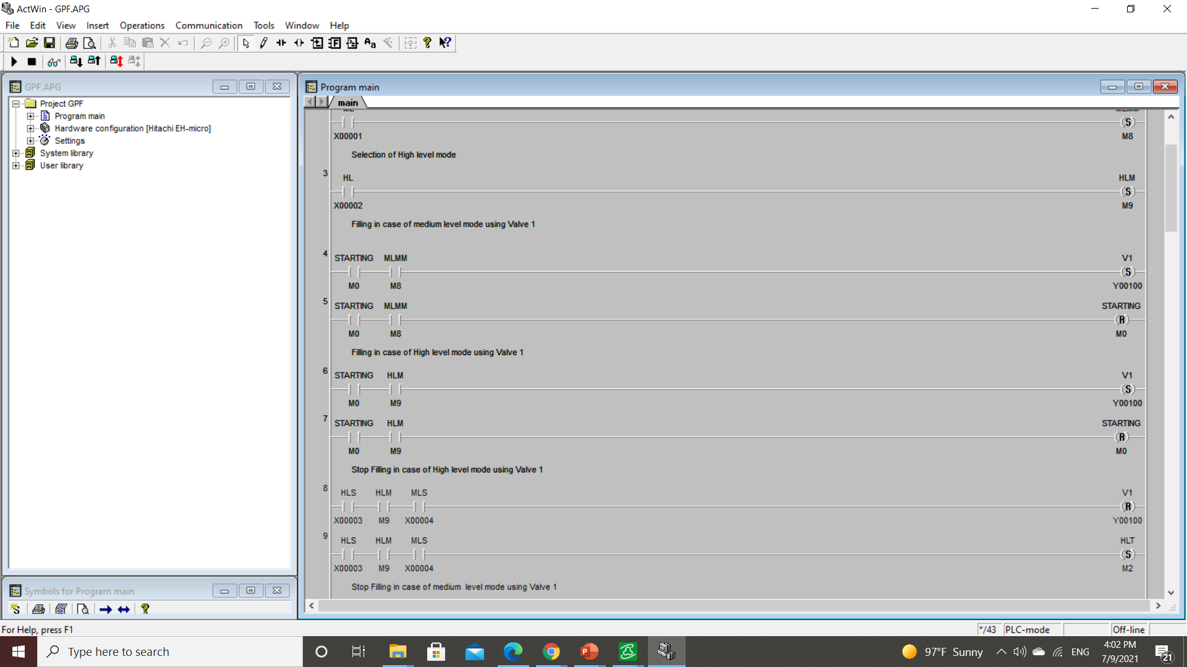
PLC programming
Start and select the process mode
Set V1 in M.L Mode Set V1 in H.L Mode

Slide 30


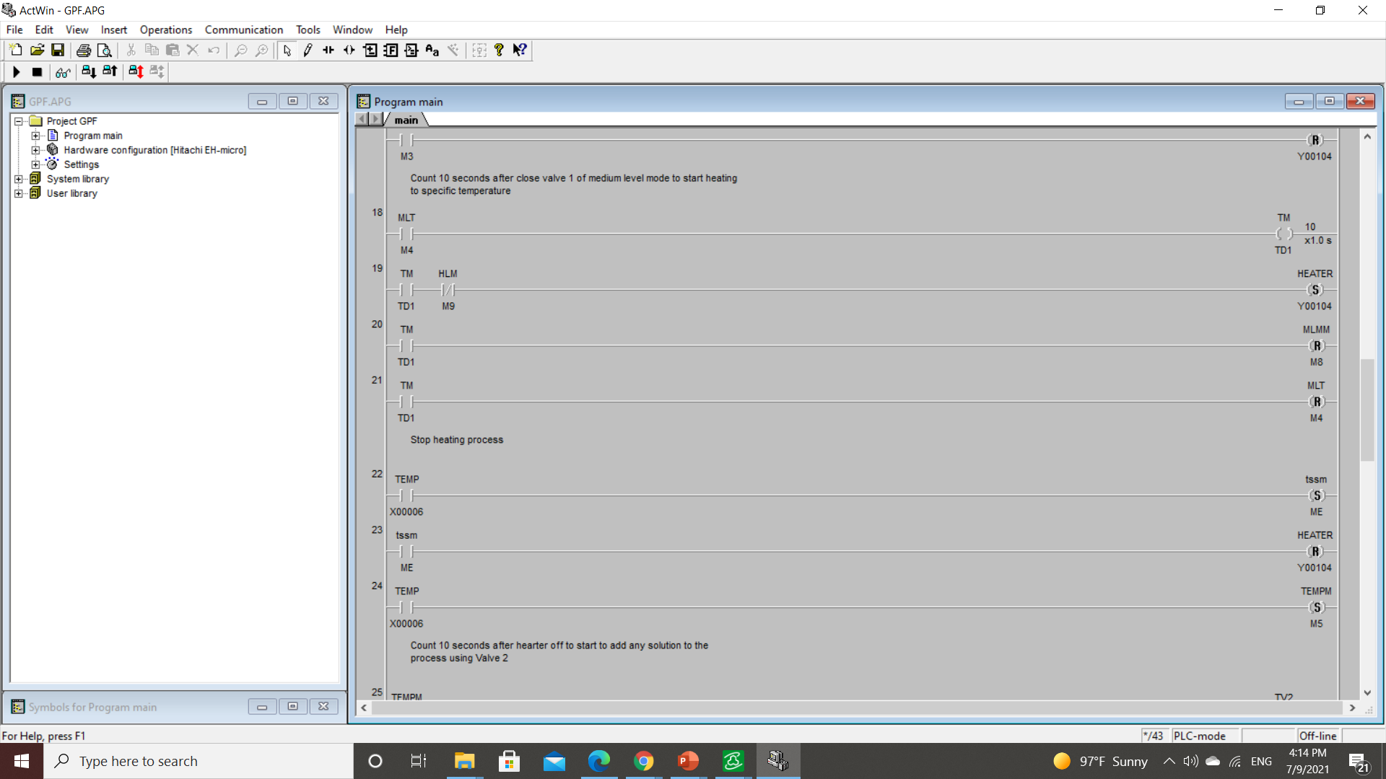

PLC programming
RESET V1 when reach M.L in case of M.L Mode RESET V1 when reach H.L in case of H.L Mode
Heating to specific Temperature in both mode

Slide 31

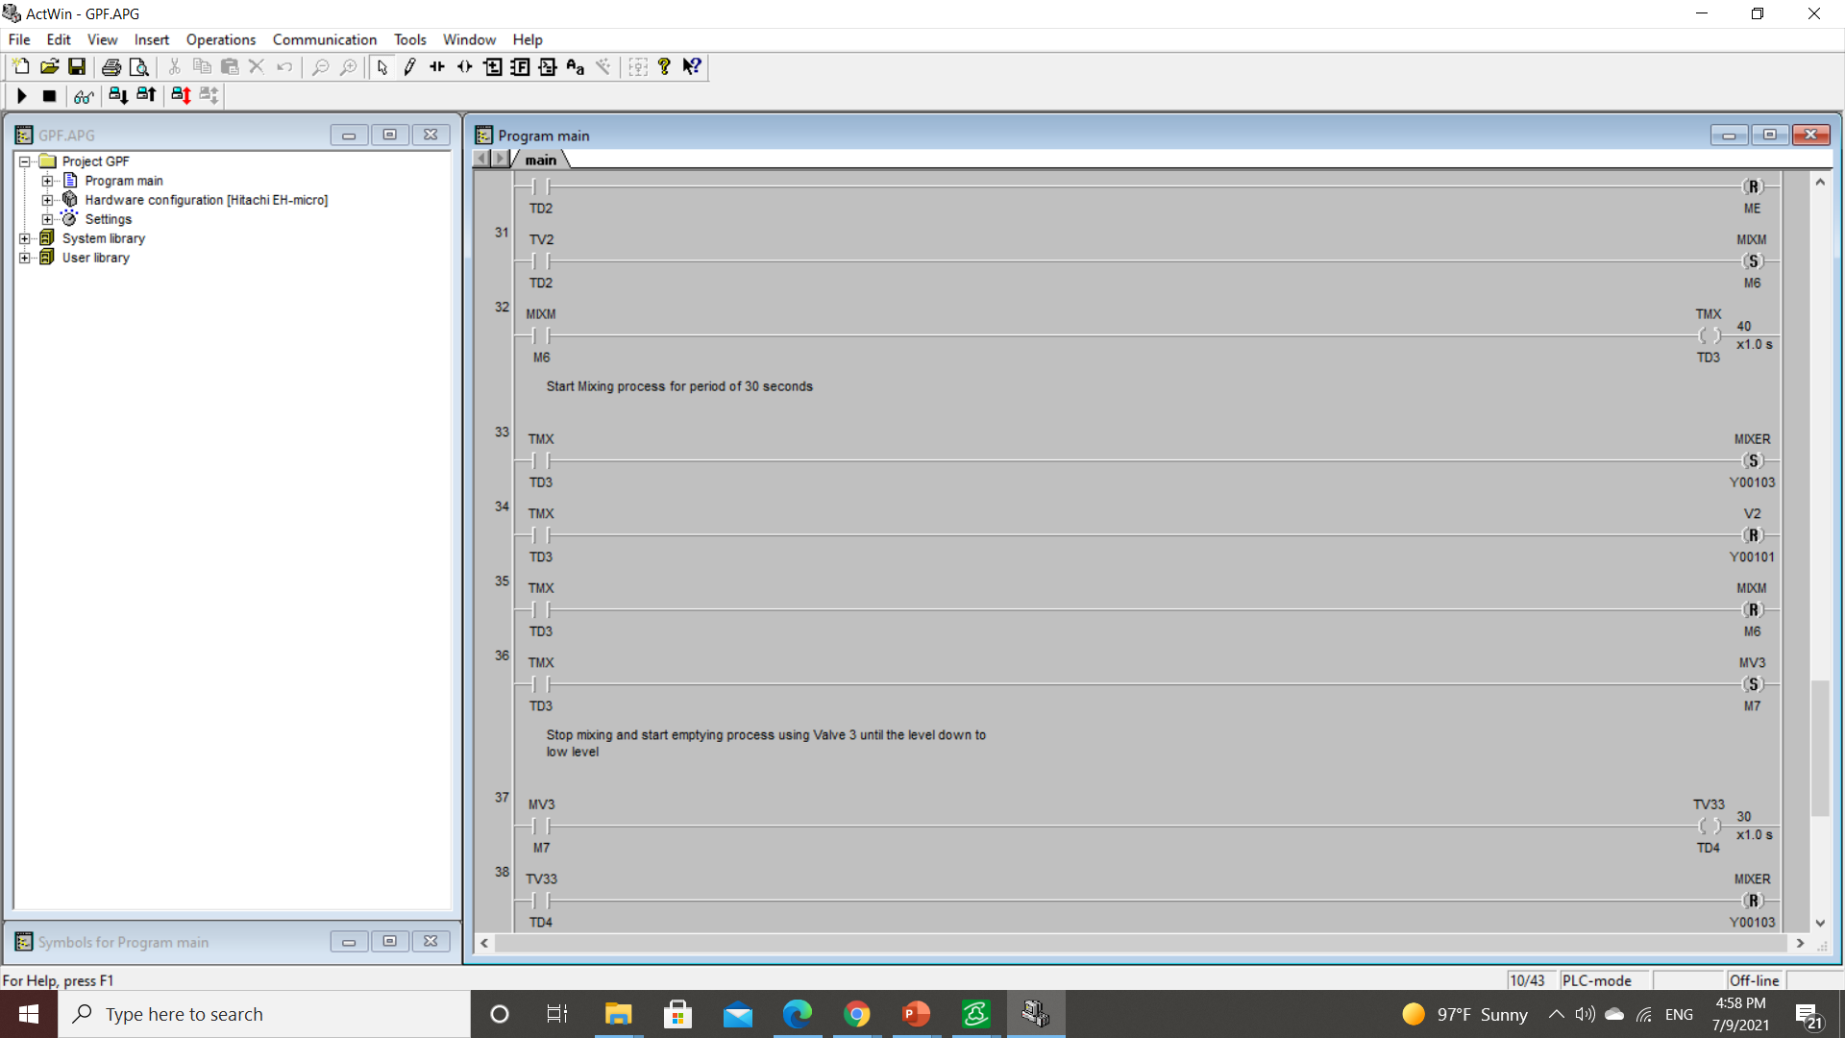
PLC programming
Set V2 to add mixing liquid
Set mixer to mix between two liquids

Slide 32
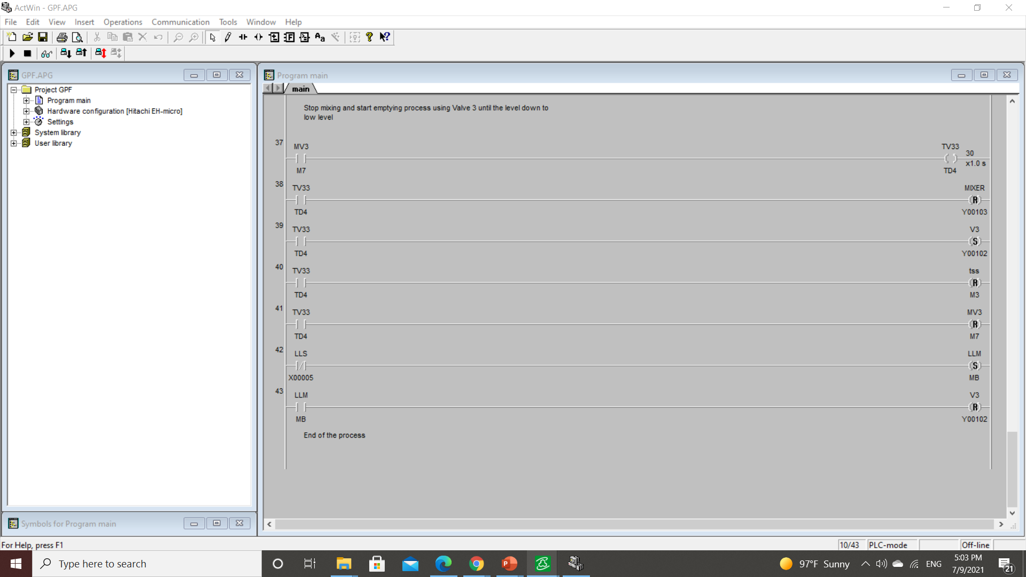
PLC programming
Emptying and set V3

Slide 33
SCADA implementation
Software used is IWS v8.0 Wonderware InduSoft Web Studio

Slide 34

SCADA implementation
Interface screen:
Add three separate screens
1: Screen for process interface
2:Screen for time, data and ….
3:Screen for control switches of the process
Then make group screen of the three screens to get all process interface

Slide 35
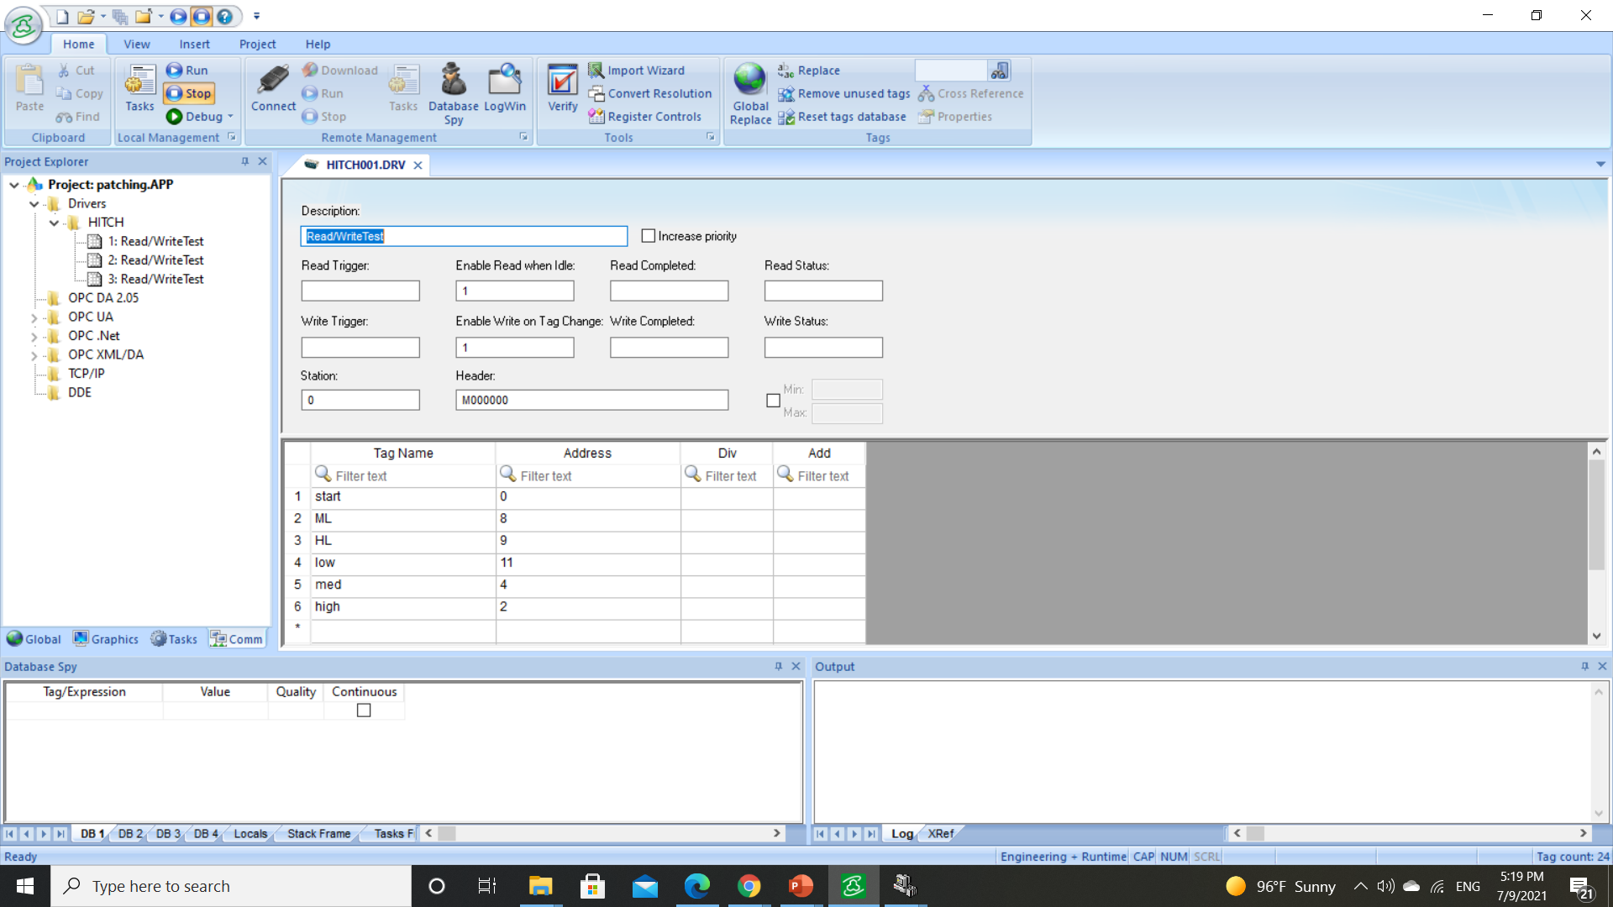
SCADA implementation
Communication: -
IWS v8.0 Wonderware InduSoft Web Studio many communication drivers which can communicate with different type of PLC SO, choose HITCH driver and initialize data sheets communication between Scada and plc for inputs, outputs and markers addresses

Slide 36
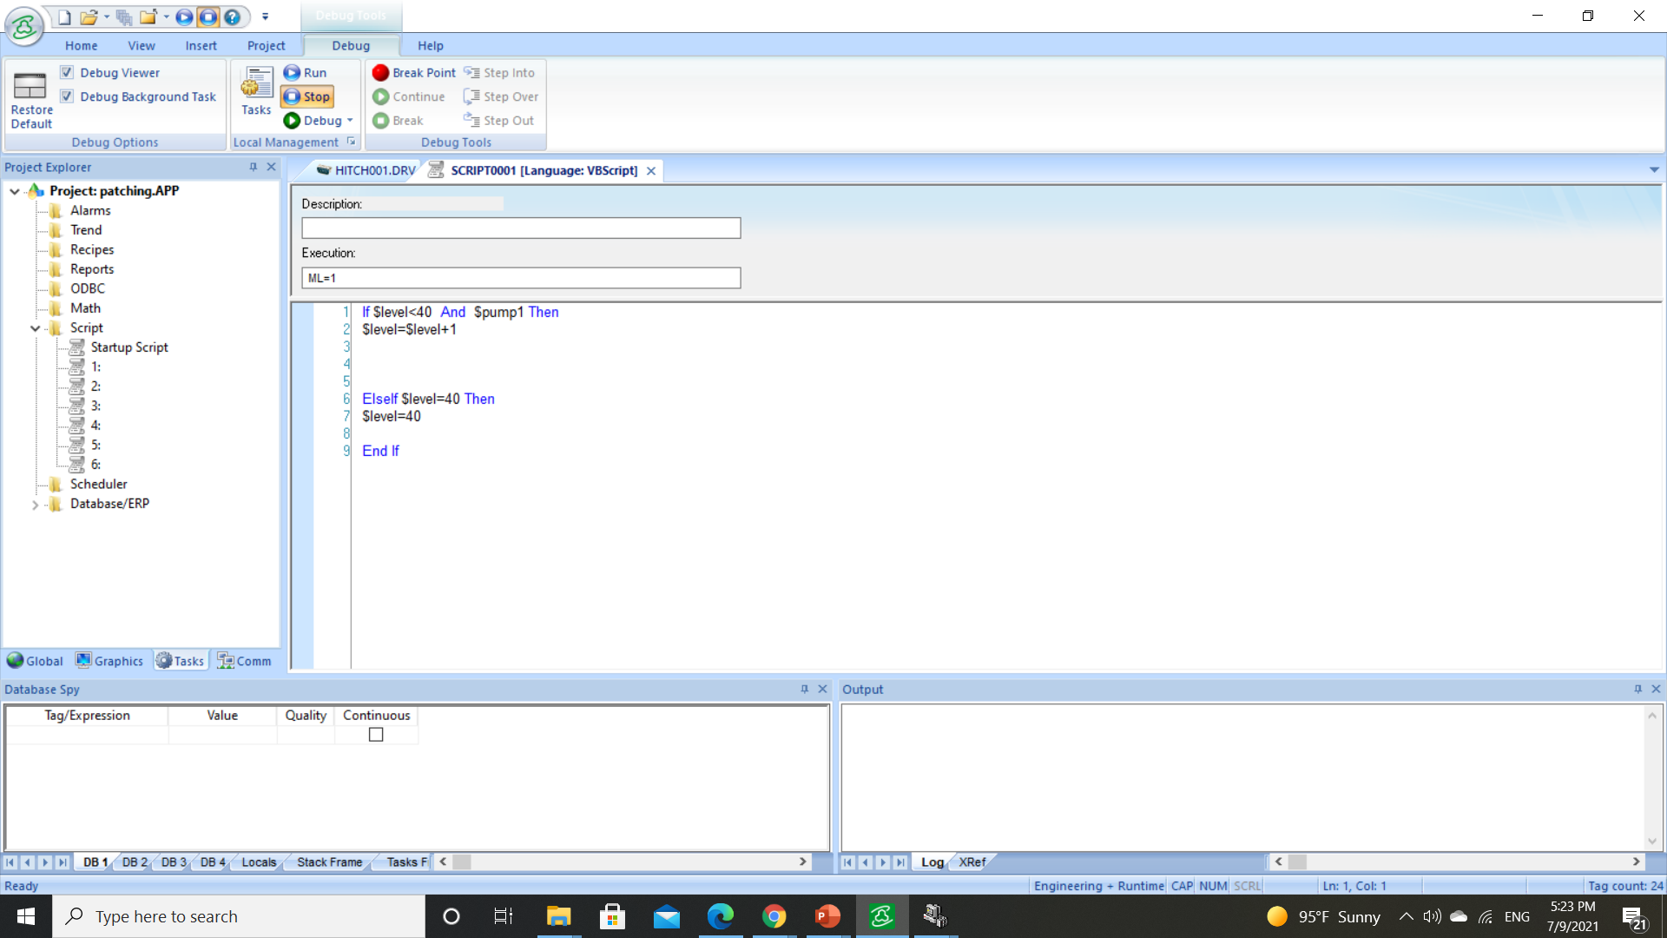
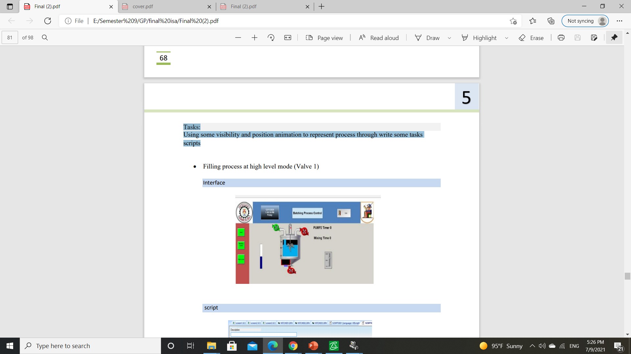
SCADA implementation
Tasks
Using some visibility and position animation to represent process through write some tasks scripts
EX: Valve 1 Animation in medium mode process

Slide 37
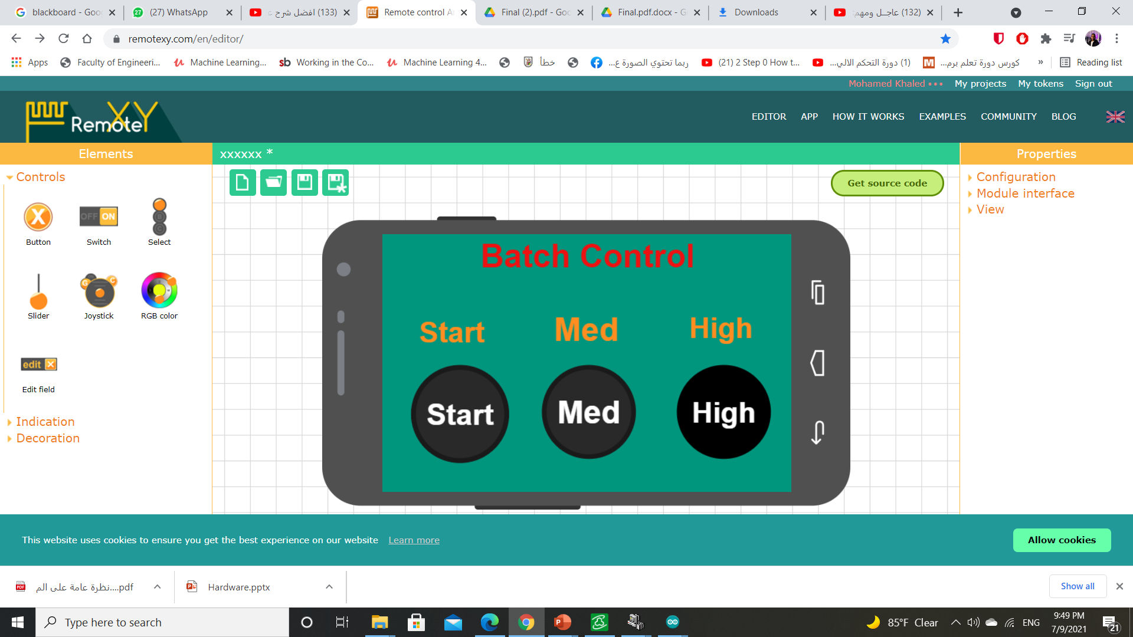
IOT
Implementing IOT using RemoteXY is easy way to make and use a mobile graphical user interface for controller boards to control via smartphone or tablet.
The interface structure is stored in the controller se we use ARDUINO
Supported communication module between application and ARDUINO is ESP8266

Slide 38
Conclusion

Slide 39
Technical Problems
Sourcing of some equipment.
Mechanical problems.
Level sensor making with the lowest cost.

Slide 40
Level Sensor Problem
Used to control the height of a liquid inside a container. They are most commonly used in conjunction with inlet and outlet valves in a liquid level control system, or in a heating and mixing application.
The problem was that at first we used the electrode method, it doesn’t work because it needs a transducer “very high cost”.

Slide 41
Level Sensor Problem
The solution: we used ultrasonic sensor with Arduino uno to sense the heights.
The benefits of this method:
1- it has low cost compared with the electrode method.
2- high efficiency.

Slide 42
Accomplishments
Getting familiar with PLC, inputs and outputs, sensors actuators and relays
Implementing simulation process on SCADA.
Complete system integration.
Report writing and documentation.

Slide 43
Thank you

